Slide 1
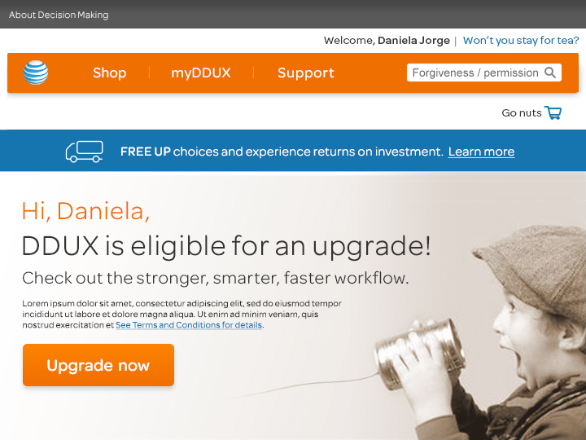
Notes:
Hi, Daniela! So glad you’re logged in!
Based on comparison of feedback from 42 senior employees and key players,
including those within and outside of UX,
we have personalized recommendations for upgrading your organization’s workflow.
Let’s consider how our workflow relates to Decision Making.

Slide 2
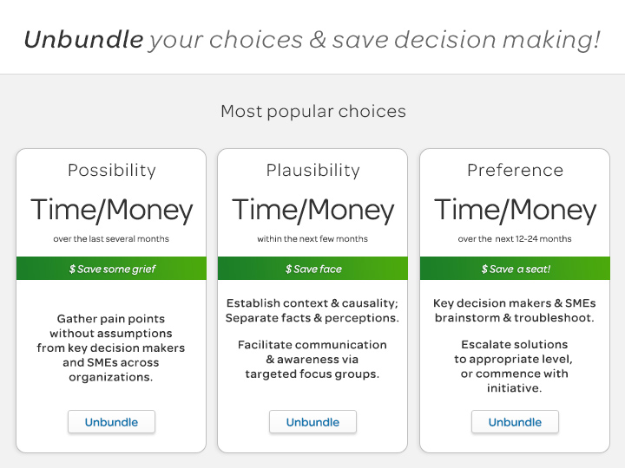
Notes:
These bundles represent a breakdown of the process leading from understanding to action.
Here’s a process for ‘unbundling your choices’:
First, consider all possible scenarios – identify key decision makers & SMEs, gather pain points without assumptions. Make it easy with a phone call, and let ‘em vent.
Next, narrow those possibilities down to establish a plausible contextual framework of common, recurring themes shared across organizations and form focus groups for discussion
Finally, connect the experts, facilitate brainstorming sessions and either escalate the most preferrable solutions, as needed, or begin taking action.
Decision making is a matter of having freedom of choice.
The Decision Making task force was given a loose premise of seeking to understand how UX relates to other groups,
for example, interaction with Business or outside vendors.
Establishing a broad contextual framework is necessary for identifying the obstacles and parameters that limit choices.
Then, we can better understand motivations that may drive decision making, impact our workflow and ultimately impact user experience.
Imagine how decision making can be empowered by liberating choices from unsavory default conditions and taxing work-arounds.
The primary proposed action is to get the experts talking to each other about how to overcome their common problems.

Slide 3
Notes:
Note:
The search field challenges the natural assumption that we must always seek authority for answers.
Of course authority has it’s place, but some situations require only
communication and exchange of awareness
so that we can feel confident to take initiative in the face of ambiguity
or to support those who do.
Sometimes merely asking a question is enough initiative.
But when a problem is urgent enough
Or of such a magnitude
Or persists long enough
And asking questions and getting no answers is persistent or costly,
There is cause enough to take license, to act autonomously, to make decisions
At least until others are available, concerned or interested enough to assist.

Slide 4
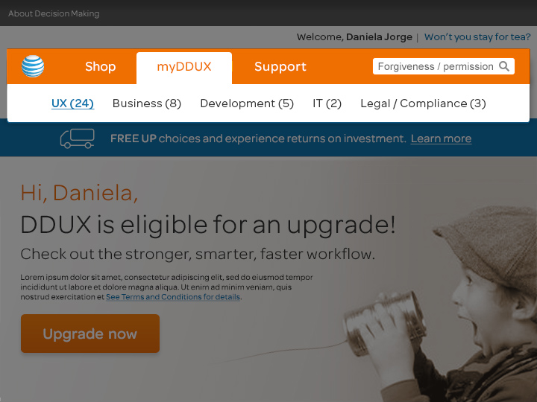
Notes:
Interviews ran between half-an-hour and one hour each,
and included 42 senior decision makers and SMEs from UX, Business, Development, IT, Legal & Compliance.
Please read the PDF report which is written in a scannable outline format
And includes additional action items and detailed feedback, broken down by organization, by topic.

Slide 5
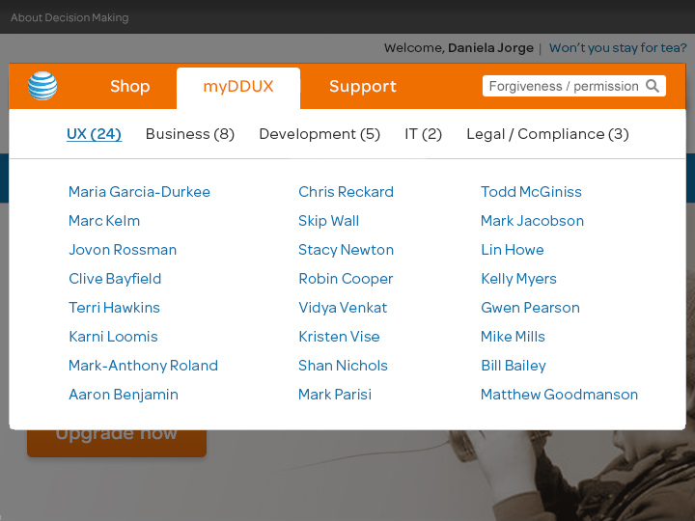
Notes:
24 interviews from UX included team members from:
- Portfolio and Sustainment
- Design
- Information architecture
- Support
- Standards
- project management,
- Usability testing
- and experience planning.

Slide 6
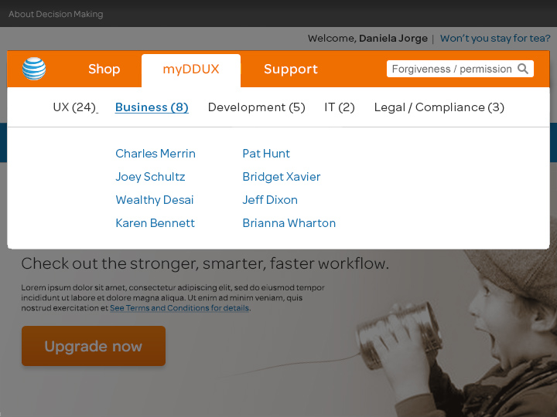
Notes:
8 interviews from Business also include feedback from AB testing.

Slide 7
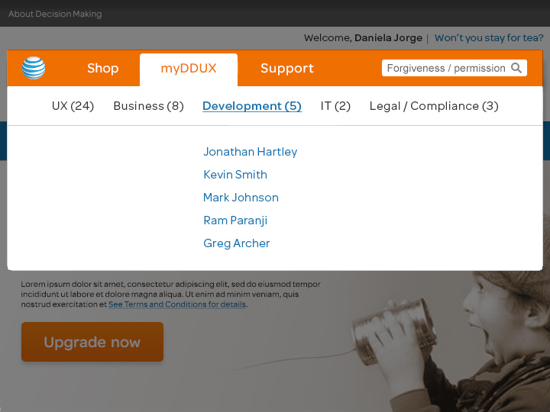
Notes:
There are 5 interviews from Development

Slide 8
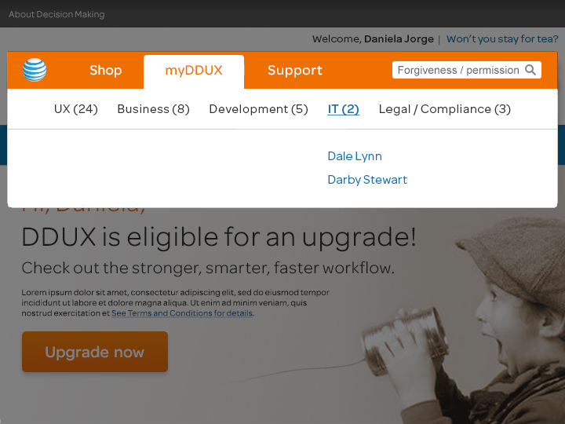
Notes:
There are 2 key voices from IT

Slide 9
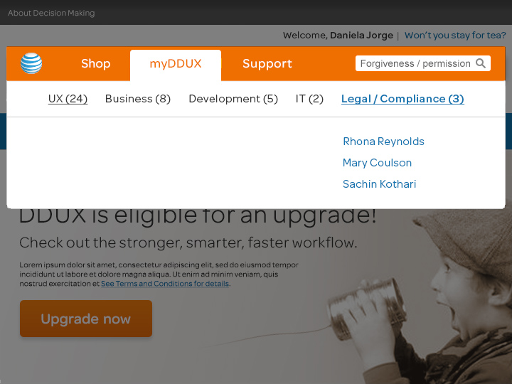
Notes:
And, there are 3 interviews with key players from Legal and Compliance.

Slide 10
Notes:
(Advance to next slide)

Slide 11
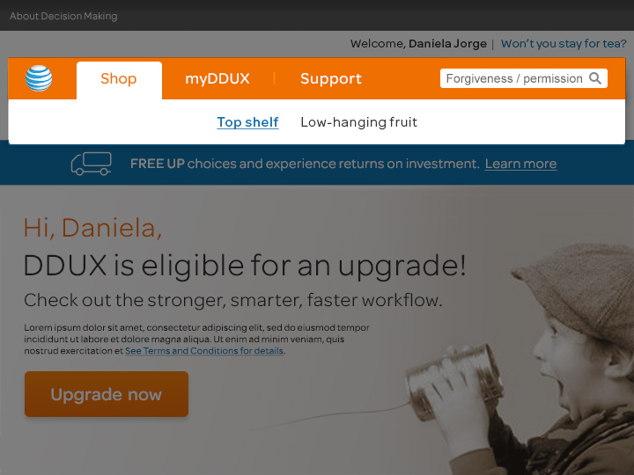
Notes:
Recurrent and outstanding pain points are divided into 2 catagories:
The list of Top shelf items include those which may require high levels of approval and/or funding.
Low-hanging fruit items include those which require initiative, reconsideration of process, and/or sharing of existing resources or awareness.
The Low Hanging fruit items are in many cases symptoms of the Top Shelf problems.
Truly, the apple doesn’t fall far from the tree.

Slide 12
Notes:
Daniela, based on usage, your most recommended Top shelf shopping choices for upgrading UX include:
Reconsideration of the relationship between UX and IT
The need for data sources and analysts
The need for and retention of Development talent
And Legal needs
Solve these and not only will you increase the speed, power and precision of UX.
Your partners will love you and we will all sing Kum-ba-yah.
Wait a minute, let’s be sure to read the Terms & Conditions…

Slide 13
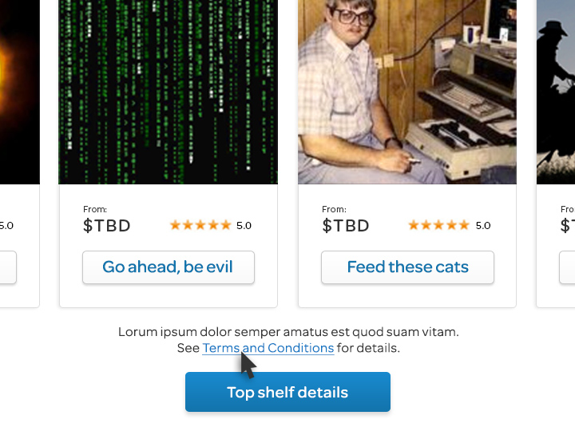

Slide 14
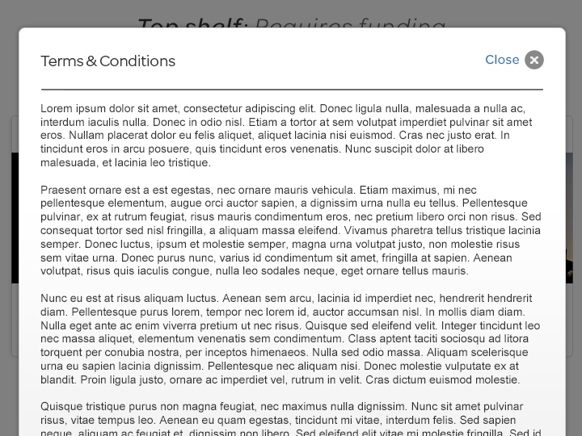
Notes:
Lorum ipsum dolor…

Slide 15
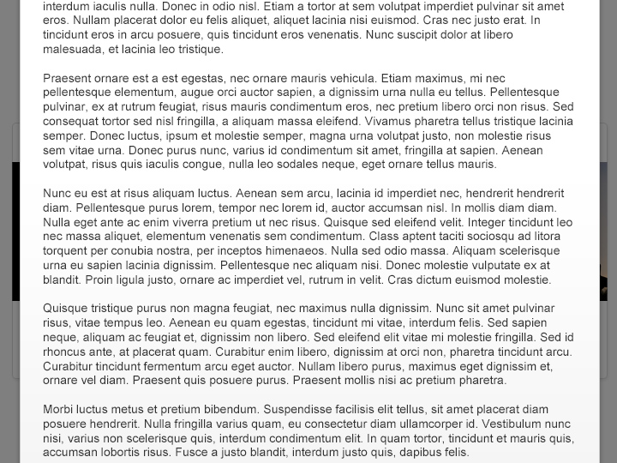
Notes:
Morbi luctus metus…

Slide 16
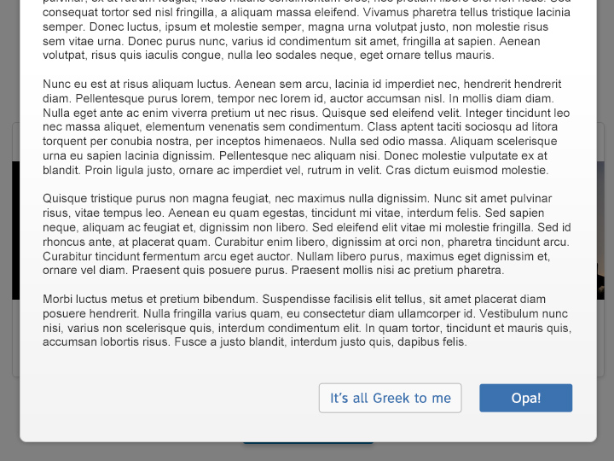
Notes:
Vestobulum…nunc…felis..
Eh…it’s all Greek to Me…
Opa!

Slide 17
Notes:
Now, in defense of the Legal team,
The root cause of our pain, as with some of our other problems,
has to do with a shortage of resources,
the challenge of achieving early engagement,
And that Legal is always avoided and treated as an after thought.
However, even when teams attempt early engagement,
Word has it that attorneys are no call, no show for meetings.
Let’s have a look at the list of complaints and accusations.
(Read slide)

Slide 18
Notes:
Okay, now that the fun one is out of the way, let’s seriously consider this one.
Probably the root of all evil in many ways, and also relates to the woeful finance model
which is already well on the radar of leadership.
(Read slide)

Slide 19
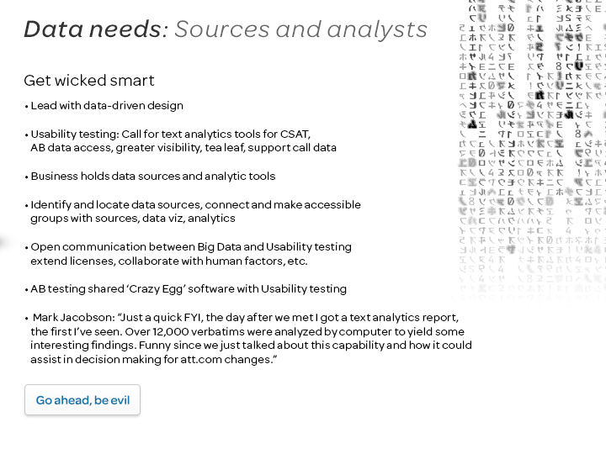
Notes:
A known and common demand, across organizations
is the need for data sources and qualified analysts.
The lack of data is a root problem exacerbating more than one
of the Low Hanging Fruit problems, which we will see in a moment.

Slide 20
Notes:
The issue of retaining dev talent relates again more to our problematic finance model.
However, paying for top shelf dev talent versus throwing more bodies at the job is another matter.
In the meantime, there are some great ideas out there about how to keep dev talent on hand,
and how to better collaborate with design.
A lot more in the report.

Slide 21
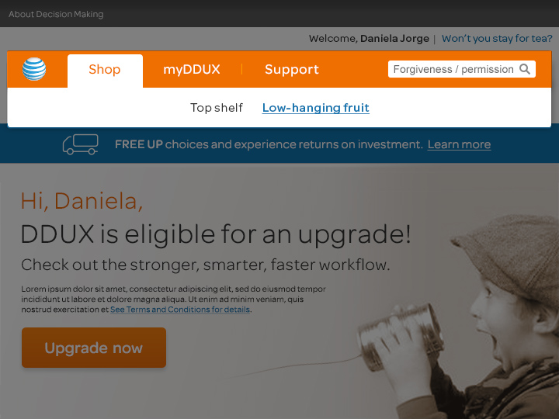
Notes:
And now for the low hanging fruit…

Slide 22
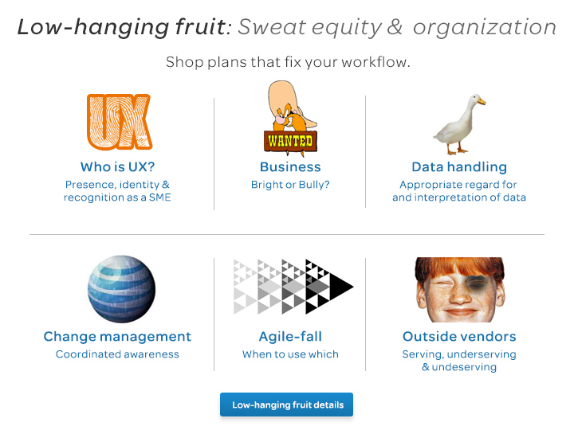
Notes:
Here’s the Low Hanging fruit menu.
There are some great, inexpensive and ripe resources already available
right under your nose.
Accessorize and be the cool kid in the cafeteria, or on the bus.
And, the big kids will stop kicking your ass on the playground.

Slide 23
Notes:
Here’s some candid feedback from our partners, and some insiders who want to help.
More related resources in the next slide.

Slide 24
Notes:
There’s a strong suspicion that this one relates to the big IT issue, but it’s not that simple.
It’s a real sore point for UX and there’s a lot of constructive feedback. Let’s have a look.

Slide 25
Notes:
Having data is one thing, but interpreting it is another.
Maybe if it were more available people would be
less inclined to see how far it can twist and stretch.
And, a lot of times it’s just honest misunderstanding.

Slide 26
Notes:
Here’s an idea straight from Krazy Matt’s UX Shak.
Matthew Goodmanson can explain in detail, and there are a few others who seem
to get where he’s coming from, possibly something Pat Hunt is working on.
Would be interesting to get this conversation started.

Slide 27
Notes:
This is something everyone feels strongly about
but it’s not always so black and white.

Slide 28
Notes:
UX’s got talent.

Slide 29
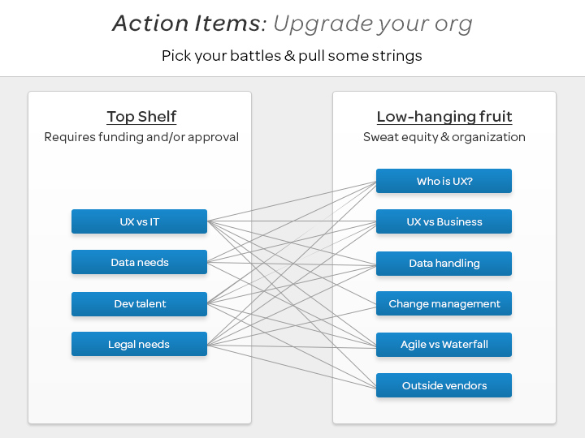
Notes:
In setting goals, keep in mind how addressing Top Shelf action items will alleviate or eliminate the Low-hanging fruit issues.
When key decision makers from UX and our partner organizations agree on the issues, the combined voices may carry enough weight to afford consideration at higher levels of approval.

Slide 30
Notes:
(pause, continue)

Slide 31
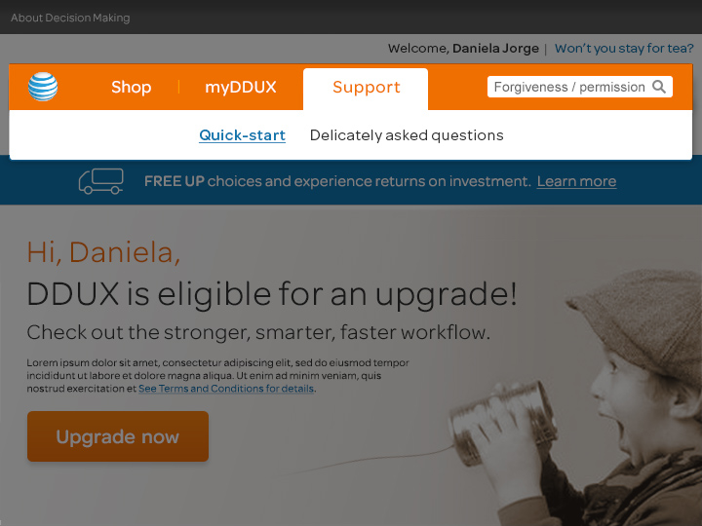
Notes:
Okay, let’s get started

Slide 32
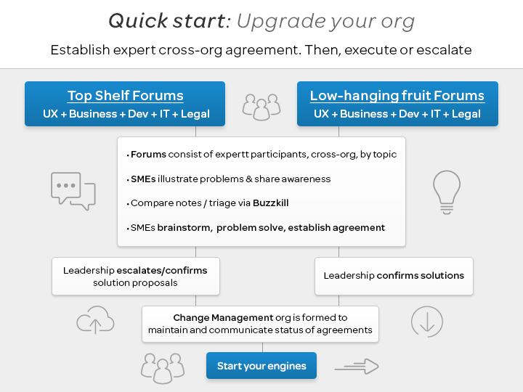
Notes:
The value of having input and agreement about pain points
from senior leaders and SMEs across organizations
who are willing to speak to the issues:
1. The validity and magnitude of the problems can be established
2. Those who have understanding can discuss and problem solve
3. Big problems can be escalated for consideration at a board level.
So, here’s a strategy for upgrading DDUX and our partners.

Slide 33
Notes:
And now for a few questions…

Slide 34
Notes:
Here are some questions that emerged from the framework of issues.
Answering some of these questions
may help frame some of the sources of tension
and also hash out some of our potential.

Slide 35
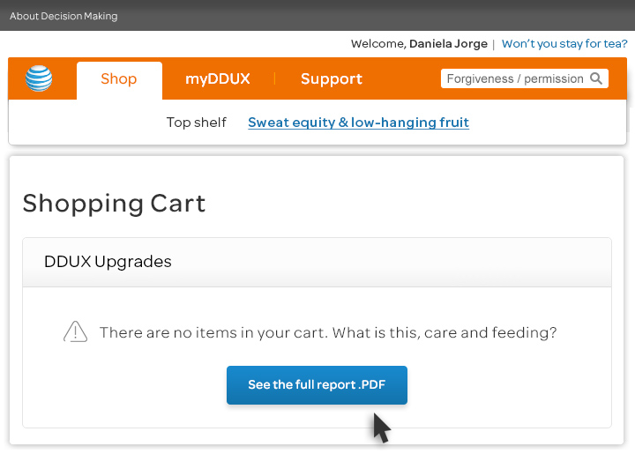
Notes:
For more dirty details, please read the full report
which is brimming with great ideas, awareness,
support and recommendations
from key decision makers and subject matter experts.
Broken down by org, by topic,
in a scan-friendly outline format.
Thanks for your attention and consideration.

